Slide 1

Team Name : NxtGen Innovators
Team Leader Name : Rahul k
Problem Statement :Build an AI-powered solution that enhances decision-making, efficiency, or user experience across retail, commerce, and marketplace ecosystems

Slide 2
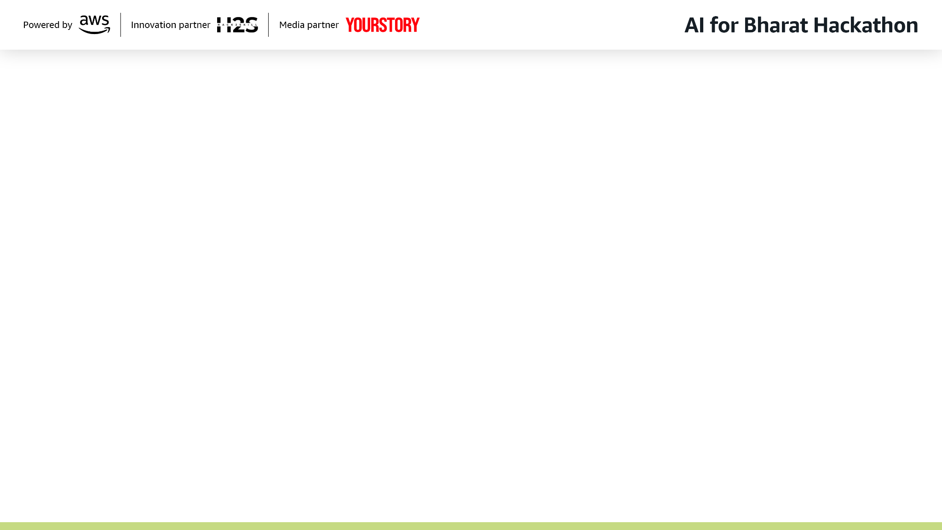
Brief about the Idea:
Medical suppliers struggle to extract insights from demand data without technical expertise
Decision-making is slow during seasonal spikes and health emergencies
We propose a GenAI-powered Demand Intelligence Agent
Users ask questions in natural language instead of writing SQL
The system uses LLMs to convert user queries into SQL

Slide 3
Fetches real-time demand data from existing databases
Applies external signals (seasonality, outbreaks)
Assigns risk levels: LOW / MEDIUM / HIGH
Generates clear, professional insights and recommendations
Result: Faster, explainable, and data-driven supply planning for medical suppliers

Slide 4
Your solution should be able to explain the following:
How is this different from existing solutions?
Most systems rely on static dashboards or manual SQL reports
Traditional tools require technical expertise to access insights
Many forecasting solutions use black-box ML models that lack explainability
Our approach:
Uses GenAI for natural language interaction with enterprise data
Provides explainable, SQL-backed insights instead of opaque predictions
Designed specifically for medical supply demand decision support

Slide 5
How does it solve the problem?
Converts user questions → SQL queries automatically
Retrieves real-time demand data from existing databases
Enhances analysis using external signals (seasonality, outbreaks)
Assigns risk levels (LOW / MEDIUM / HIGH) for quick decision-making
Generates clear, professional insights for planners
Result: Faster, easier, and data-driven supply planning without technical barriers

Slide 6
USP of the Proposed Solution
AI-powered natural language access to demand data
Fully explainable — grounded in database queries
Healthcare-focused demand intelligence
Real-time insights without needing ML model training
Usable by non-technical decision-makers

Slide 7
List of features offered by the solution
Natural language demand queries
AI converts questions into SQL
Real-time data from enterprise databases
External signals (seasonality, outbreaks)
Risk levels: LOW / MEDIUM / HIGH
AI-generated insights & recommendations
Transparent, explainable results

Slide 8
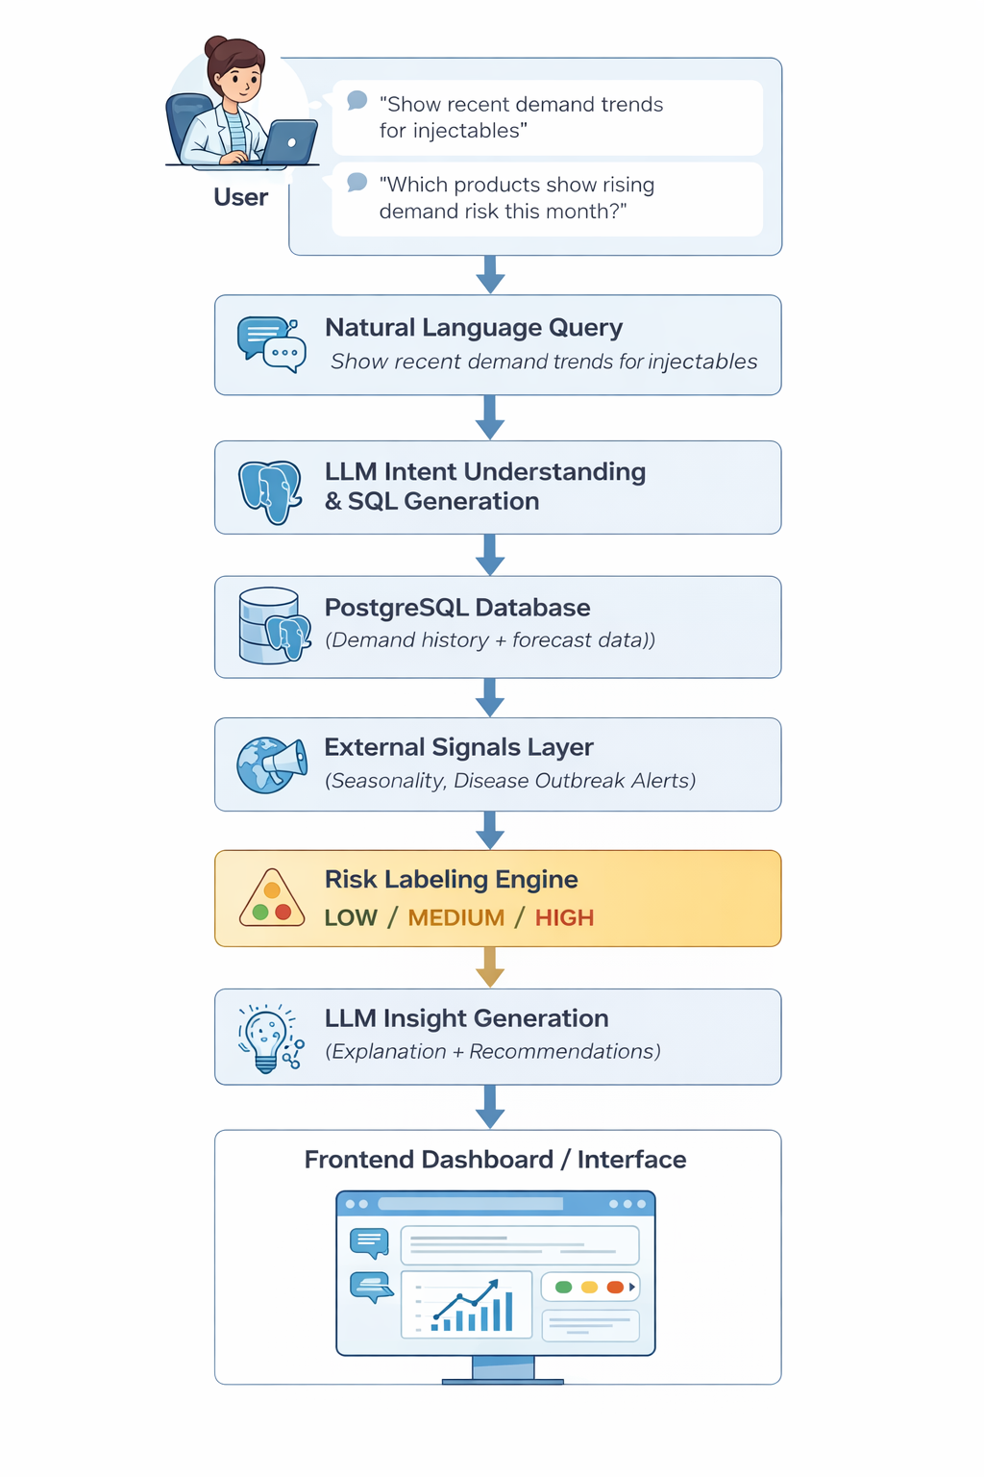
Process flow diagram or Use-case diagram

Slide 9
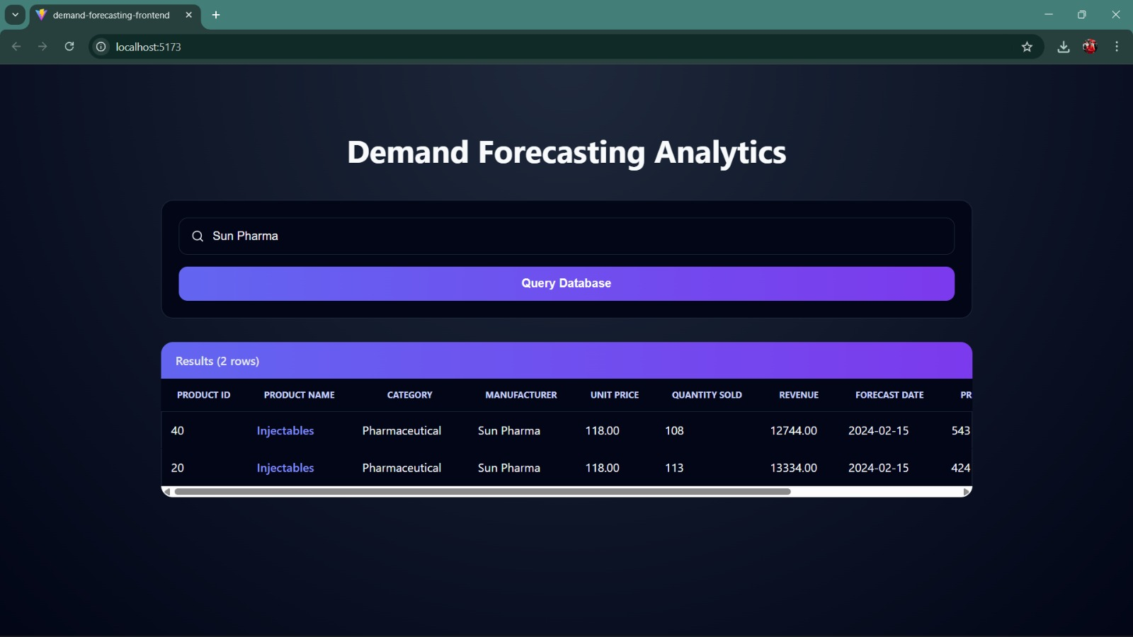
Wireframes/Mock diagrams of the proposed solution (optional)

Slide 10
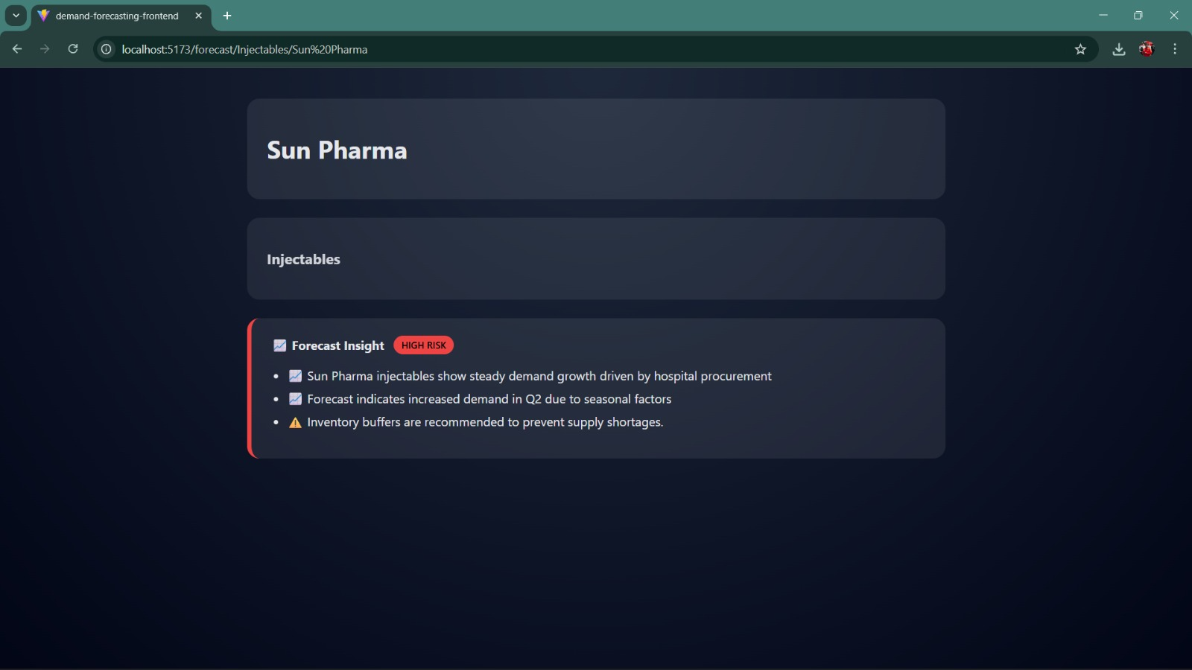

Slide 11
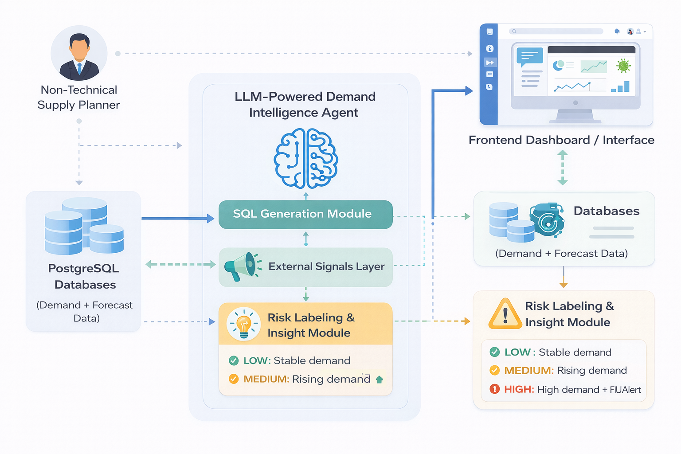
Architecture diagram of the proposed solution:

Slide 12
Technologies to be used in the solution:
Frontend: React.js (User Dashboard & Query Interface)
Backend API: FastAPI (Python)
Database: PostgreSQL (Demand & Forecast Data)
AI Model: LLM via OpenRouter API (NL → SQL & Insights)
Language: Python
Data Processing: SQL Queries & Rule-Based Logic

Slide 13
Estimated implementation cost (optional):

Slide 14
Meaningful Use of AI Uses Generative AI for natural language understanding and automated SQL generation
Solves a Real-World Problem Helps medical suppliers make faster, data-driven demand planning decisions
Innovative Application of AI Combines AI reasoning with structured healthcare demand data
Explainable & Responsible Design Outputs are grounded in database queries, not black-box predictions
Feasible & Scalable Solution Built using practical technologies that integrate with existing systems
User-Centric Approach Designed for non-technical supply planners using simple natural language

Slide 15


